Slide 1

Project Title -
Healthcare Analytics for Doctor Visits TIRTC Project
Student AICTE ID- STU6a2c2581ab2571781278081
College- Takshshila Institute Of Engineering And Technology
[UMANG BARSHE]

Slide 2

PROBLEM STATEMENT
Healthcare providers and planners need to understand the underlying patterns of doctor visits across various demographic, socioeconomic, health-status, and healthcare-access variables. To address this, the project analyzes historical patient records to identify descriptive trends in healthcare utilization and highlight the key factors influencing doctor visits, which can ultimately guide resource planning and warrant further clinical or administrative investigation.

Slide 3
Project Description
This project, "Healthcare Analytics for Doctor Visits," provides an end-to-end descriptive analysis of patient healthcare utilization using historical visit records. It cleans and examines a healthcare dataset across multiple dimensions, including patient demographics (age, gender), socioeconomic status (income), health conditions (illness levels, chronic conditions), and healthcare access (insurance types, free care programs). Through exploratory data analysis, statistical summaries, data visualizations, and correlation tracking, the notebook identifies specific patient segments with high utilization and highlights factors associated with frequent doctor visits. The core objective is to deliver data-driven insights that assist healthcare providers and planners in resource management and service planning, establishing clear descriptive patterns without implying medical causation.

Slide 4

WHO ARE THE END USERS?
the primary end users are professionals involved in the operational, analytical, and administrative sides of healthcare:
Healthcare Providers: Medical professionals and clinic operators who need to understand underlying patterns in doctor visits across different demographic (age, gender), socioeconomic, and health-status variables.
Healthcare Planners and Administrators: Operational leaders who use these insights for service-planning purposes and resource allocation. The analysis helps them monitor patient groups with high utilization rates and plan healthcare resources specifically for segments with chronic conditions or high illness levels.
Healthcare Data Analysts and Researchers: Since the project is explicitly designed for "healthcare analytics and project-reporting purposes," analysts serve as key users. They use this exploratory baseline to investigate unusual visit counts, improve data documentation, and build future statistical models (such as Poisson or negative-binomial regression) to predict count outcomes.

Slide 5
Github Link
https://github.com/barshemoney-bot/Healthcare-Analytics-for-Doctor-Visits-TIRTC-by-Umang-Barshe.git
https://github.com/barshemoney-bot/Healthcare-Analytics-for-Doctor-Visits-TIRTC-by-Umang-Barshe.git

Slide 6

Technology Used
  Here are the specific technologies used:
  Programming Language: Python 3.
  Data Manipulation & Analysis:
  Pandas: Used for loading the dataset, data cleaning, aggregation, and organizing the data structure.
  NumPy: Used for numerical operations, array handling, and mathematical calculations.
  Data Visualization:
  Matplotlib: Used for foundational plotting and creating figures.
  Seaborn: Used for advanced statistical visualizations, including histograms, bar charts, scatter plots, and correlation heatmaps.
  Development Environment: Jupyter Notebook and Google Colab, which provide the interactive environment for writing code, displaying outputs (IPython.display), and documenting the project.
  Data Format: CSV (Comma-Separated Values) format is used to load and ingest the initial dataset.

Slide 7
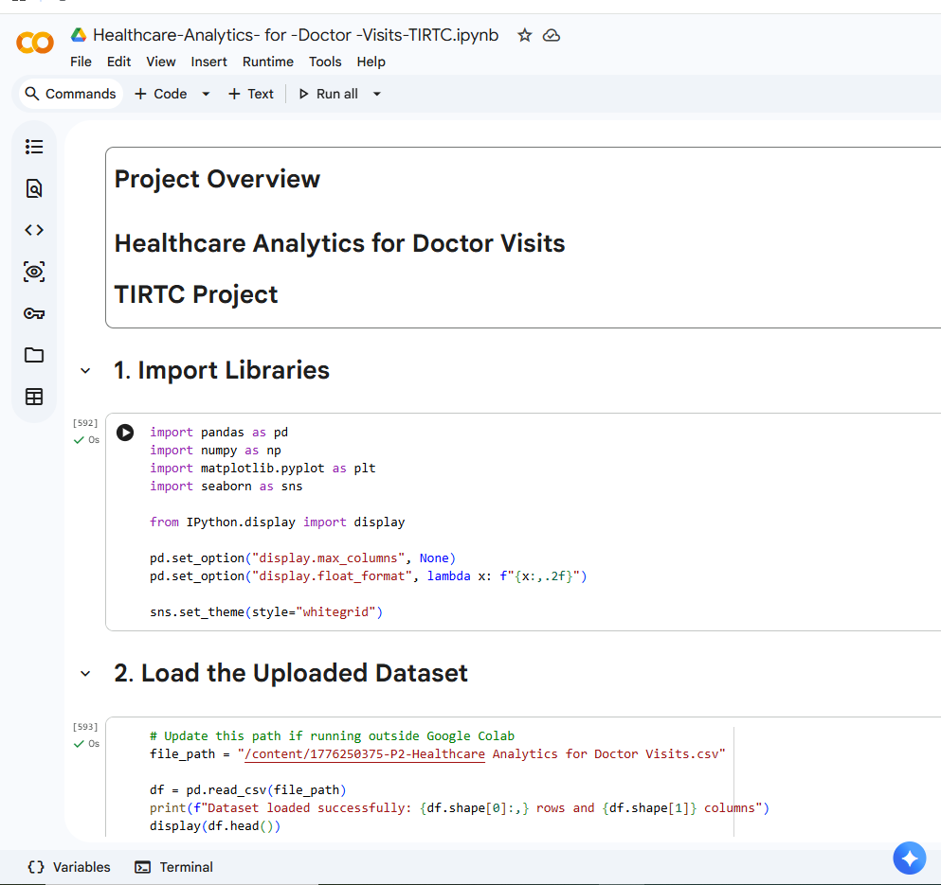
RESULTS
Screenshot

Slide 8
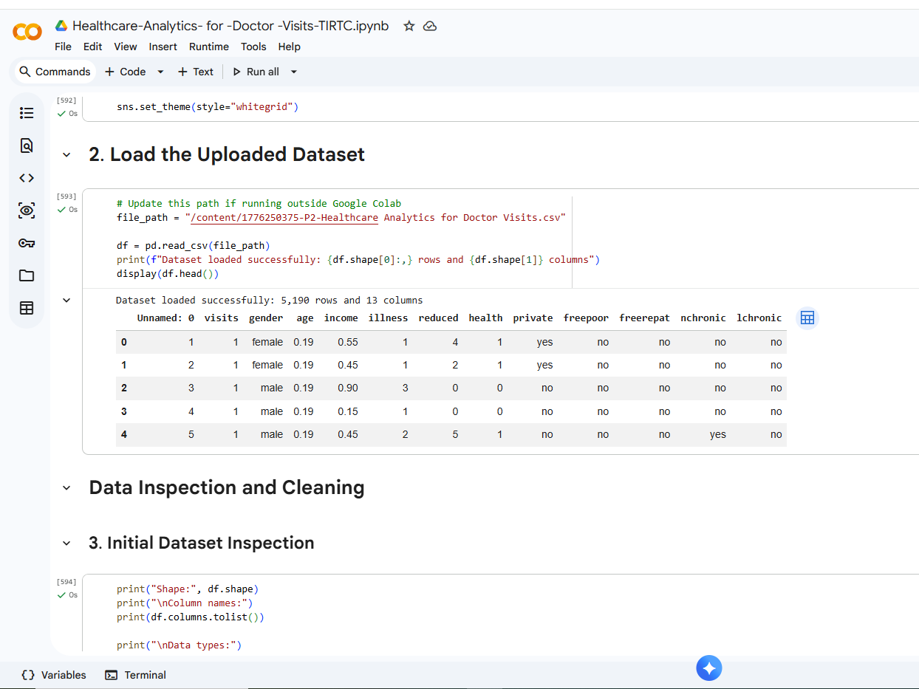
RESULTS

Slide 9
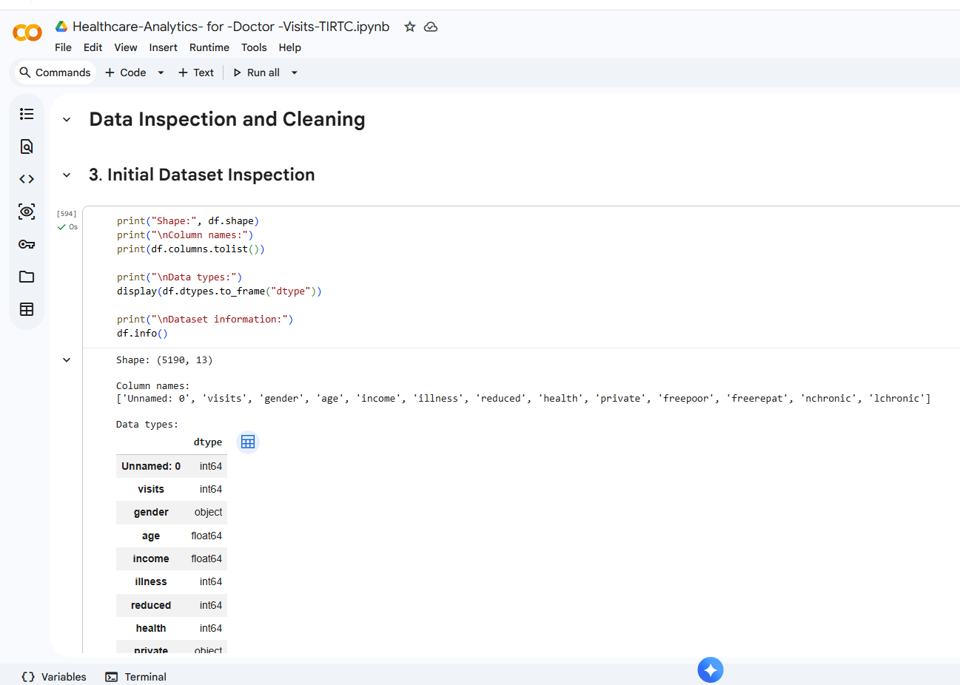
RESULTS

Slide 10
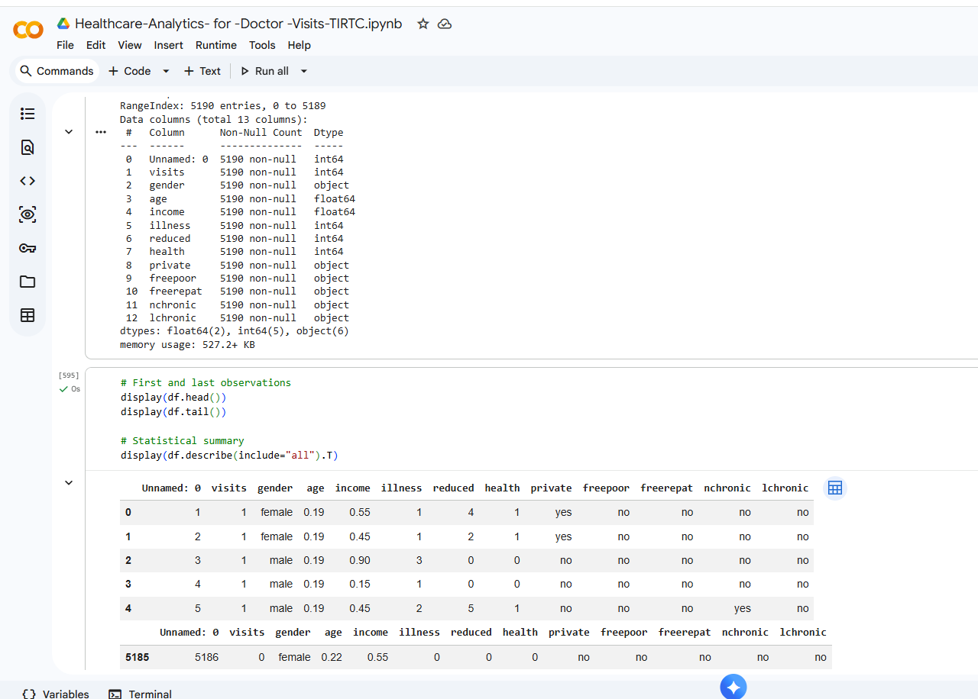
RESULTS

Slide 11
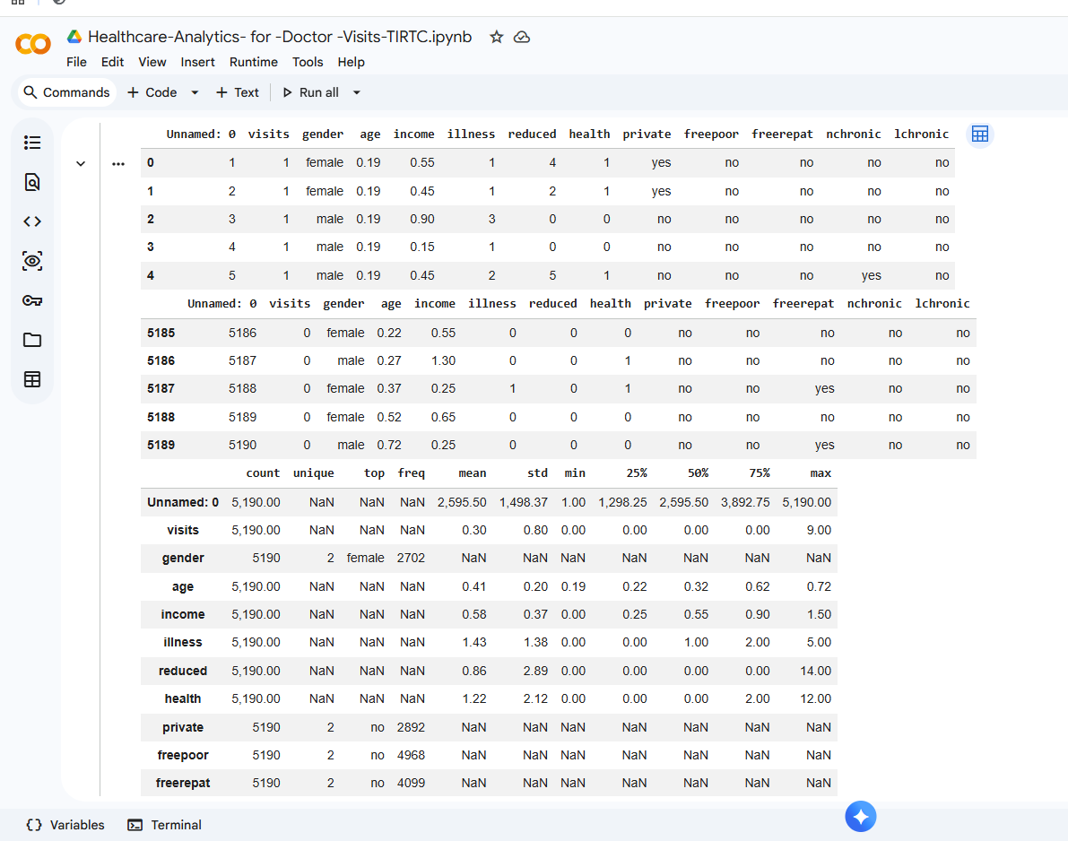
RESULTS

Slide 12
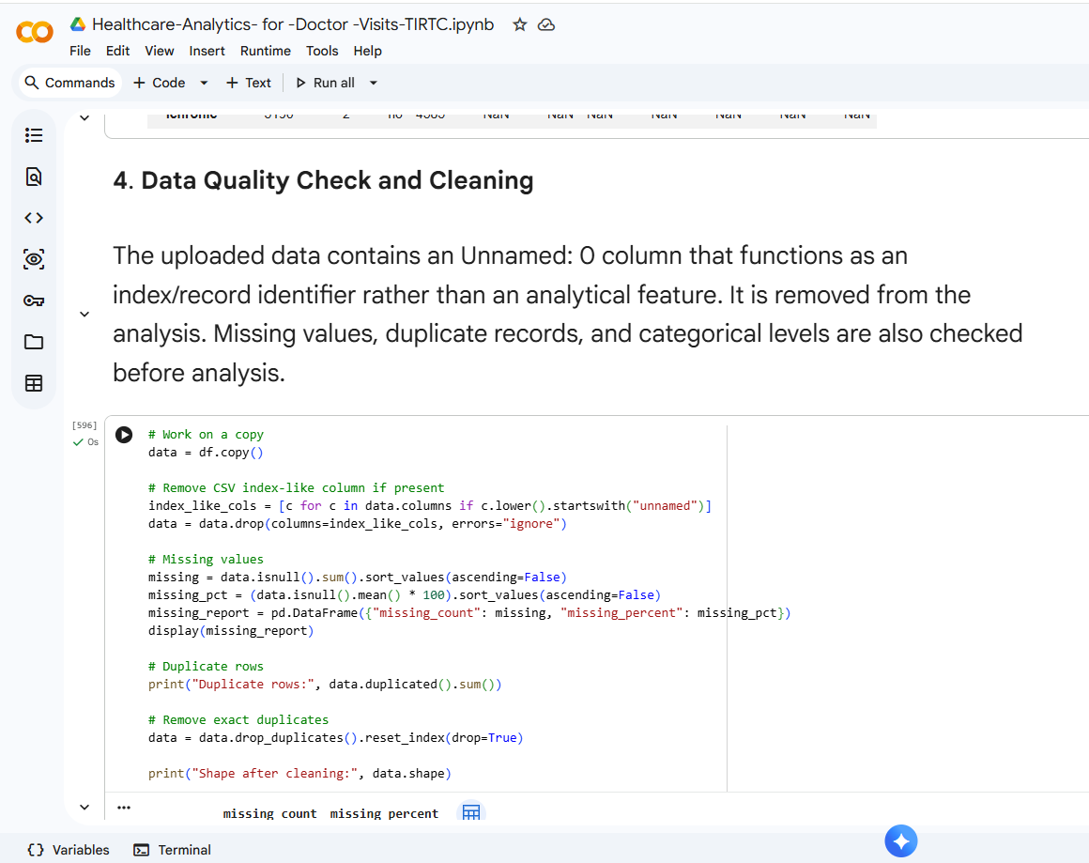
RESULTS

Slide 13
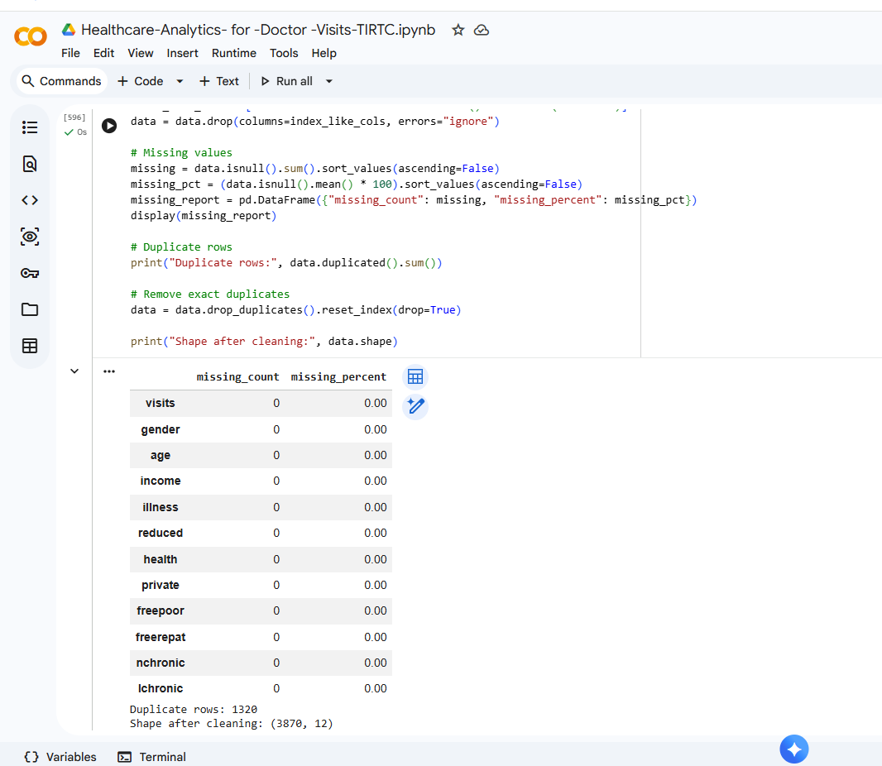
RESULTS

Slide 14
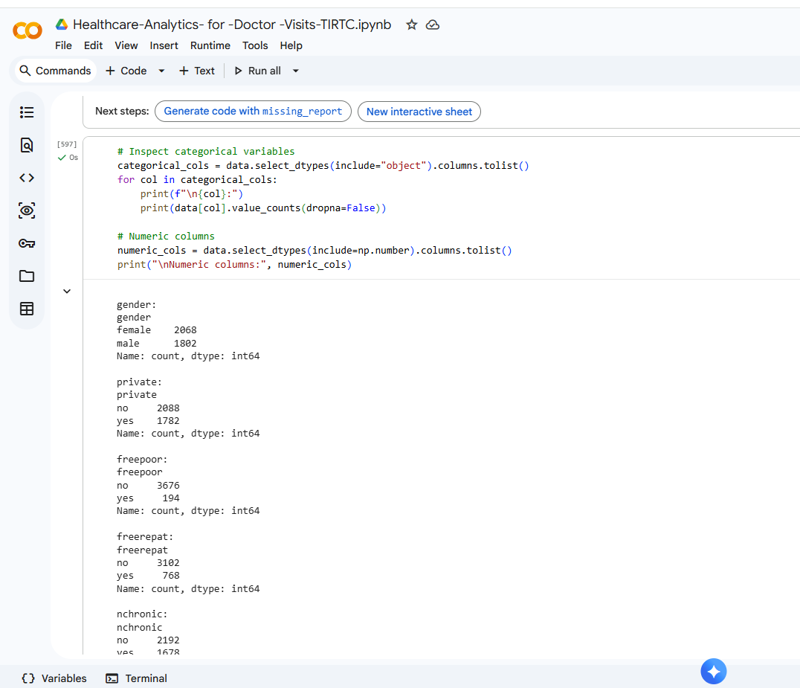
RESULTS

Slide 15
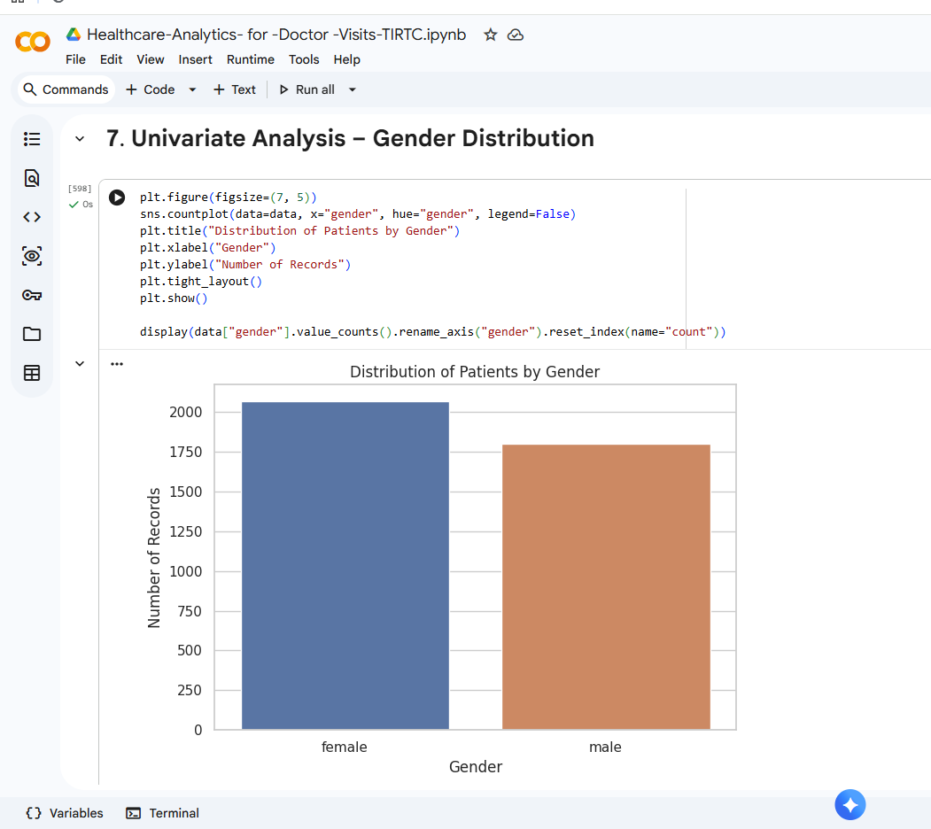
RESULTS

Slide 16
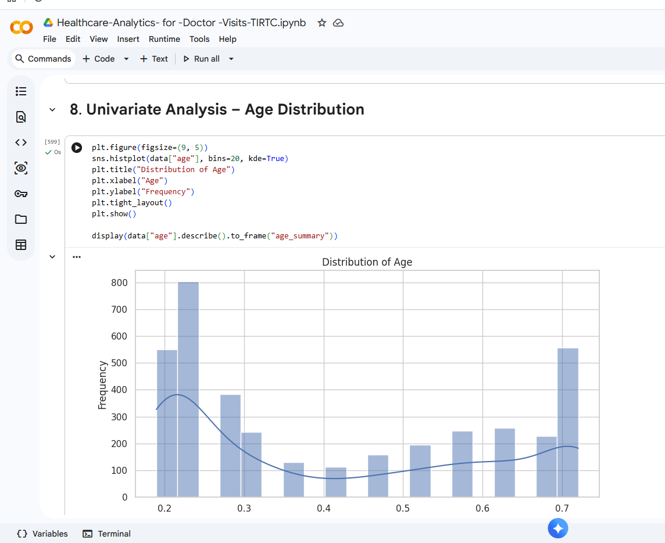
RESULTS

Slide 17
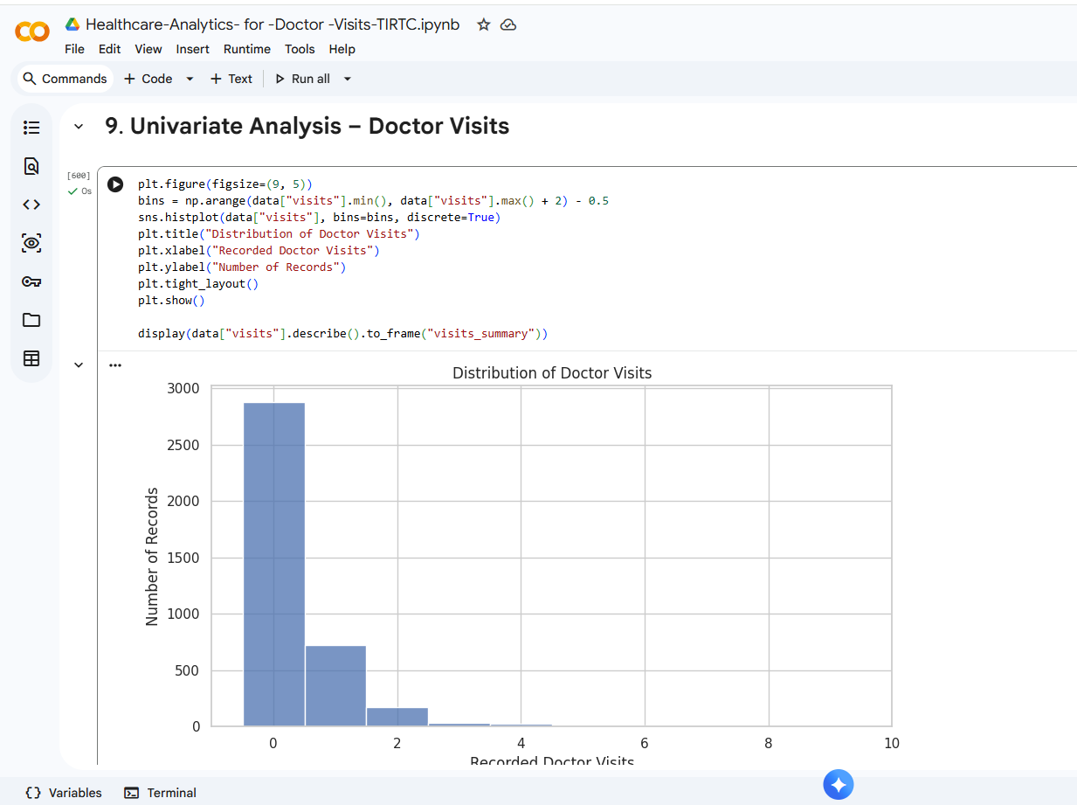
RESULTS

Slide 18
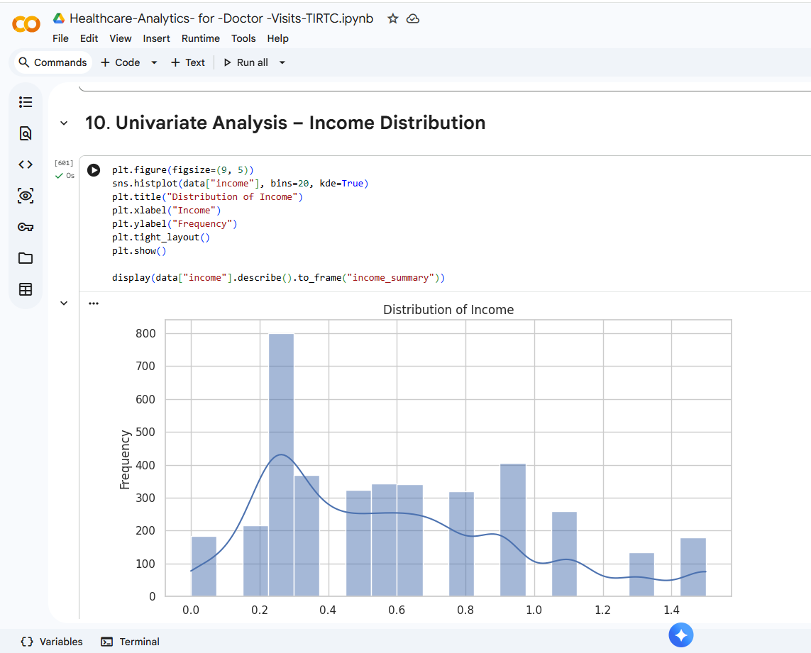
RESULTS

Slide 19
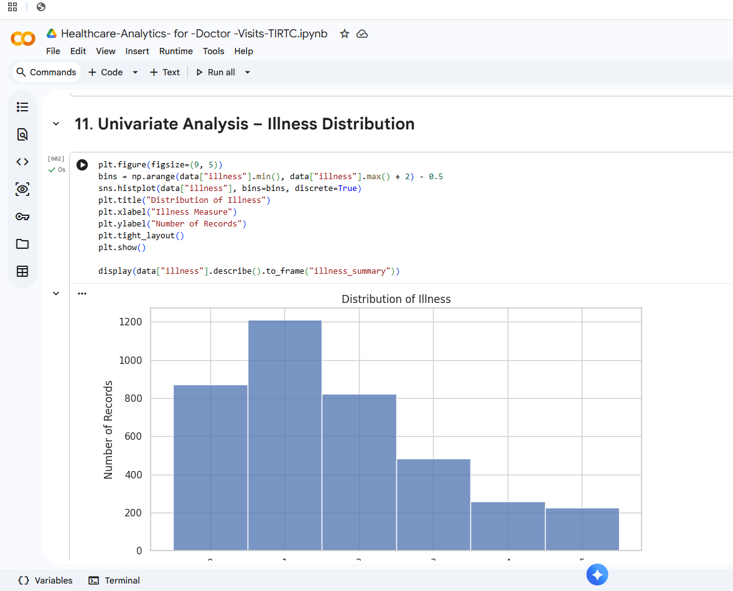
RESULTS

Slide 20
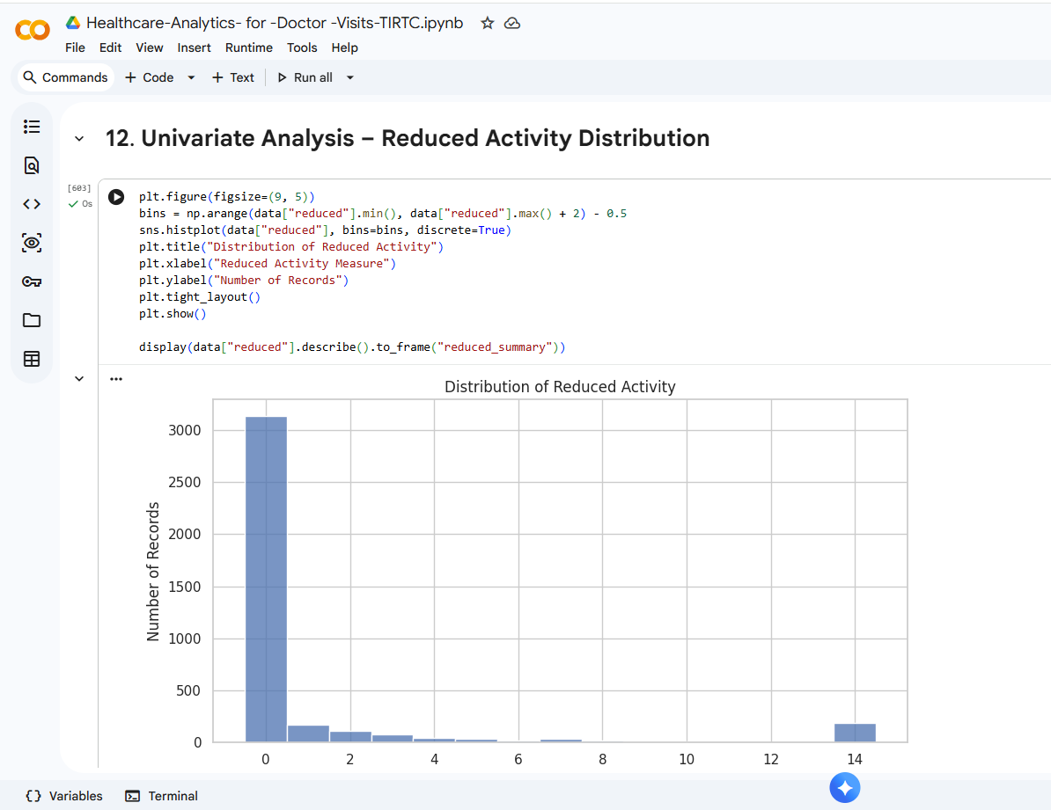
RESULTS

Slide 21
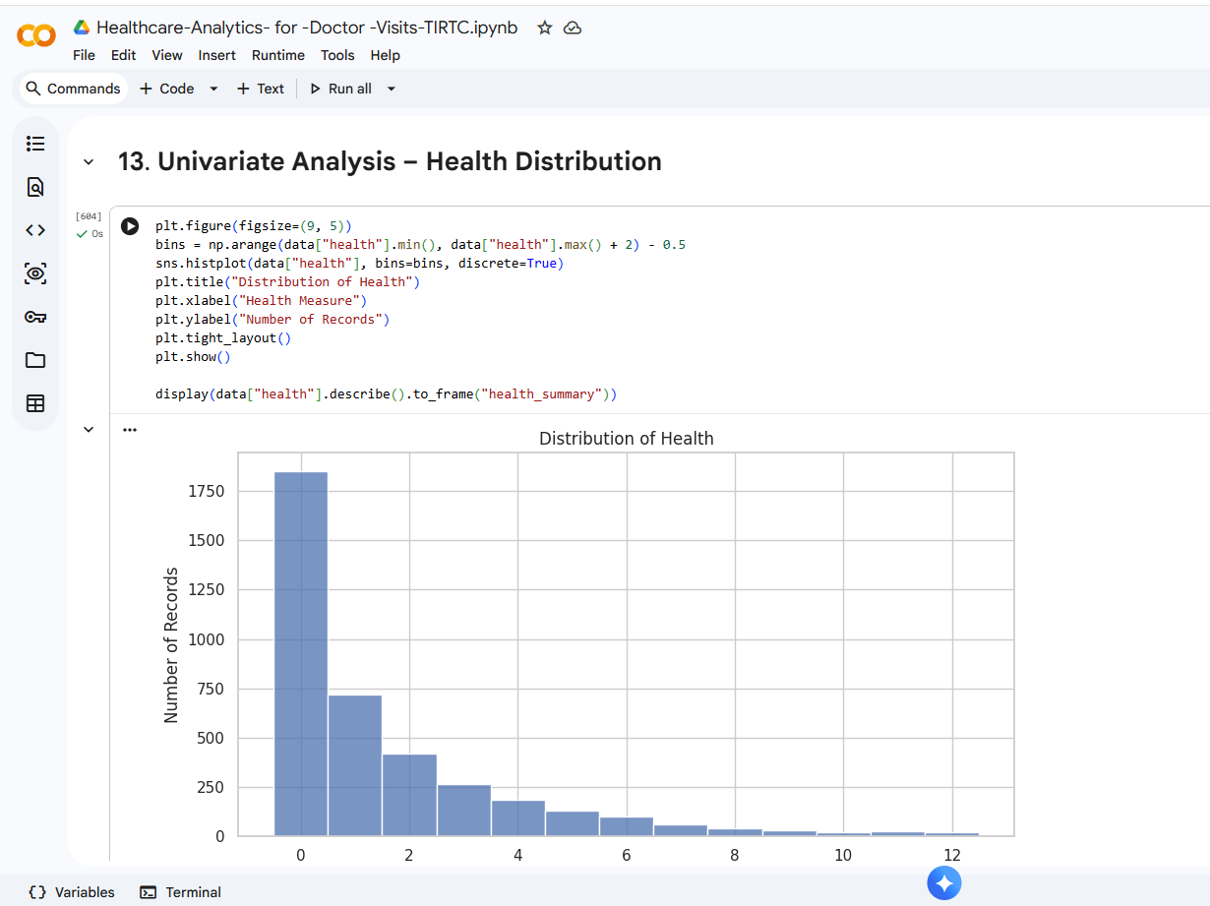
RESULTS

Slide 22
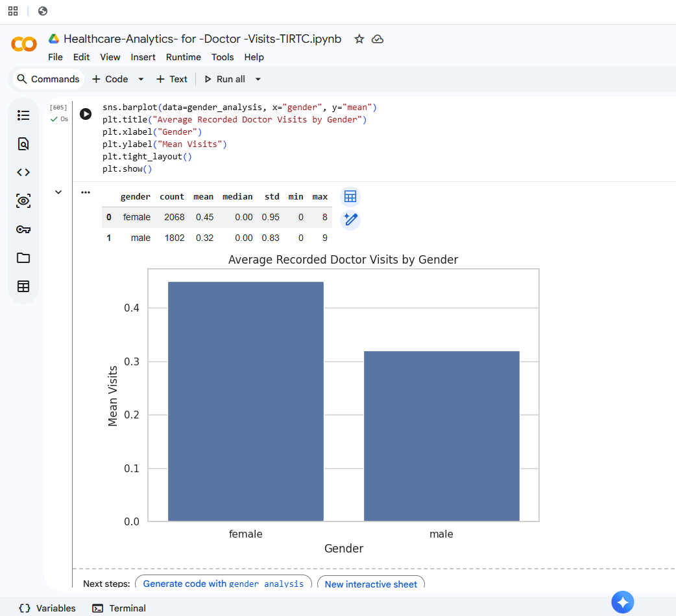
RESULTS

Slide 23
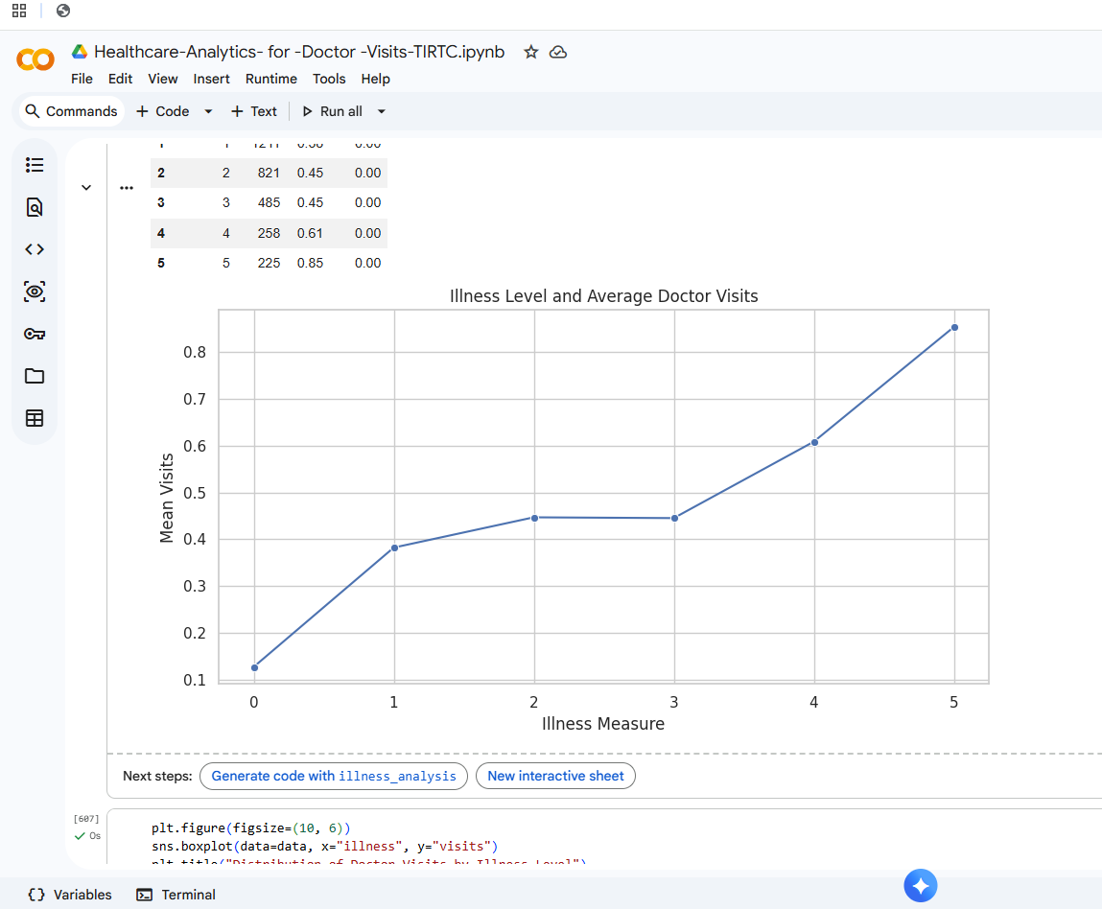
RESULTS

Slide 24
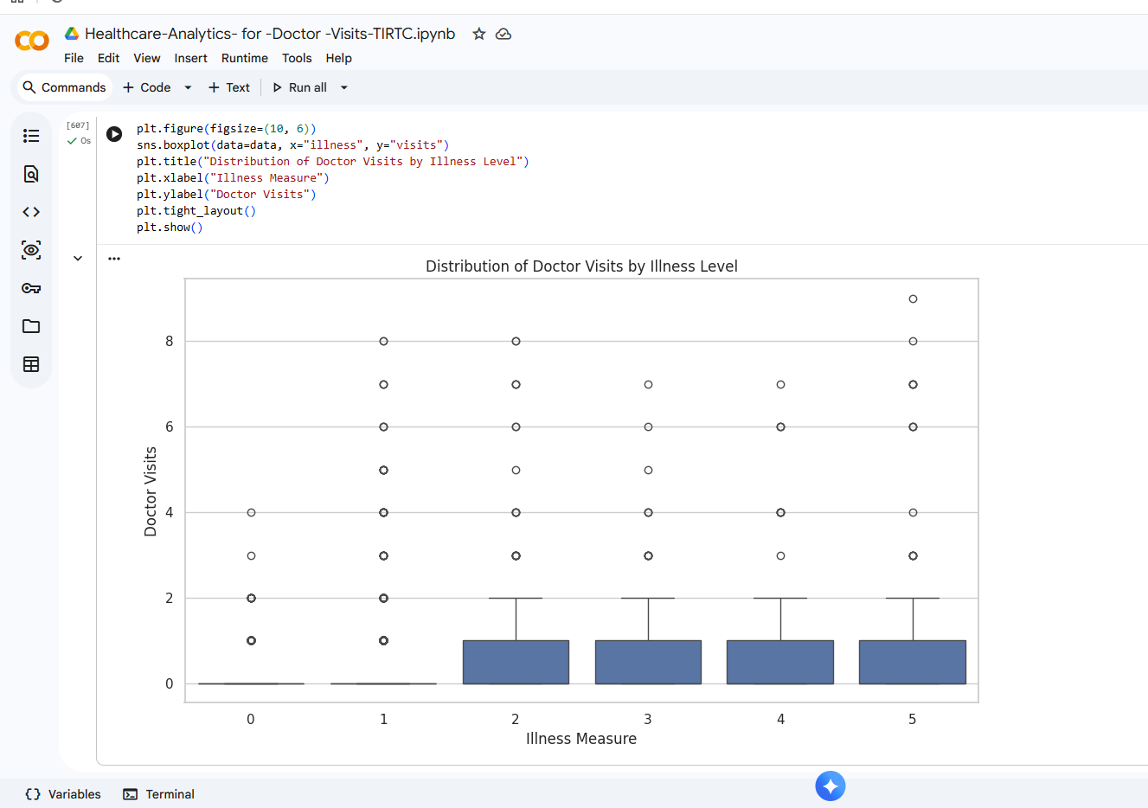
RESULTS

Slide 25
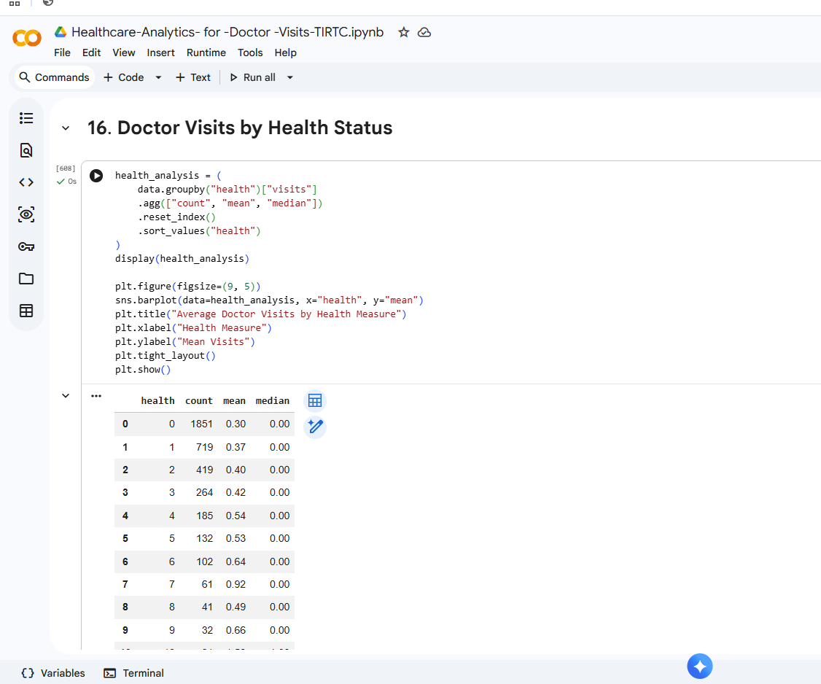
RESULTS

Slide 26
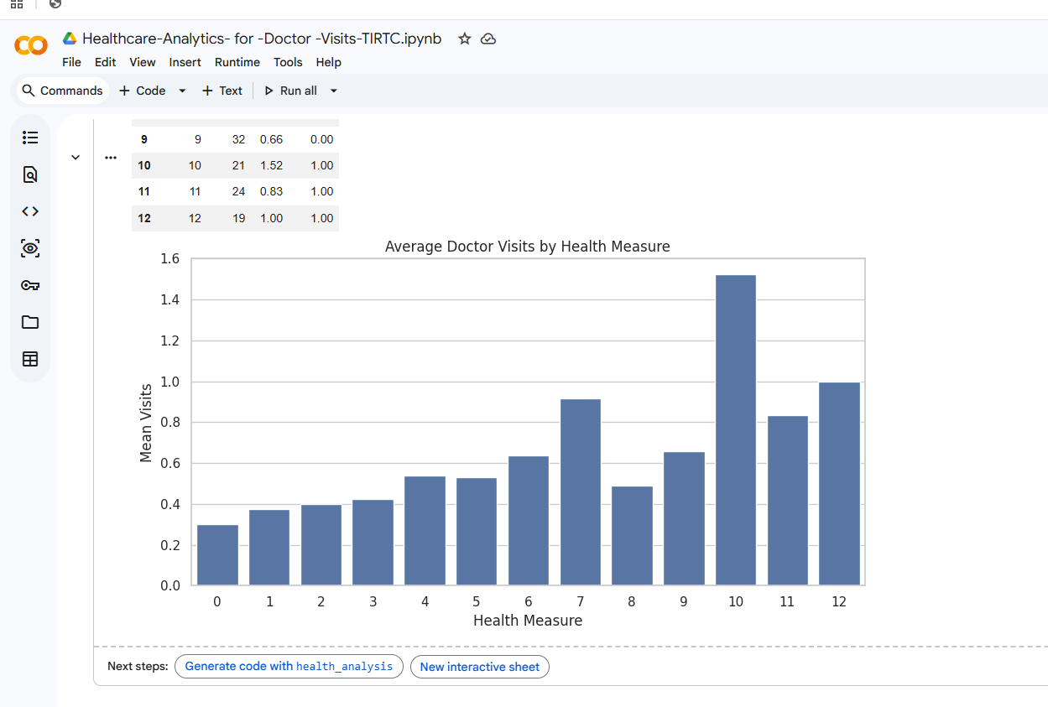
RESULTS

Slide 27
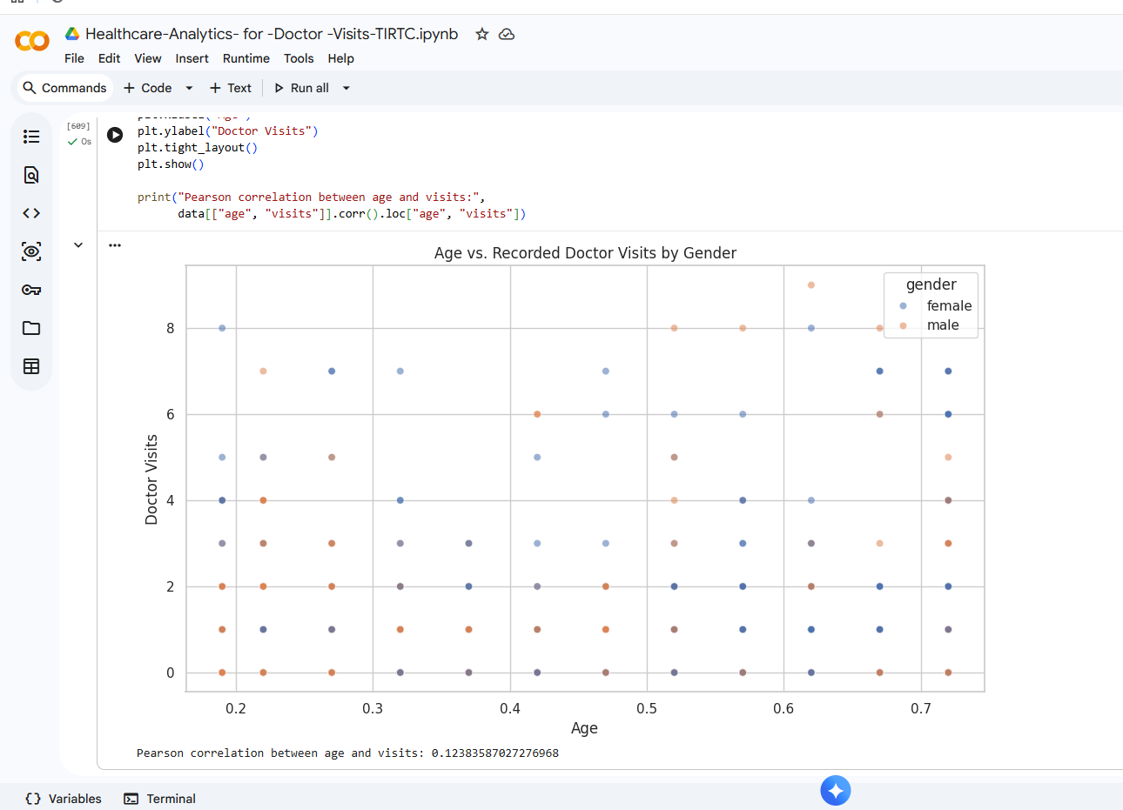
RESULTS

Slide 28
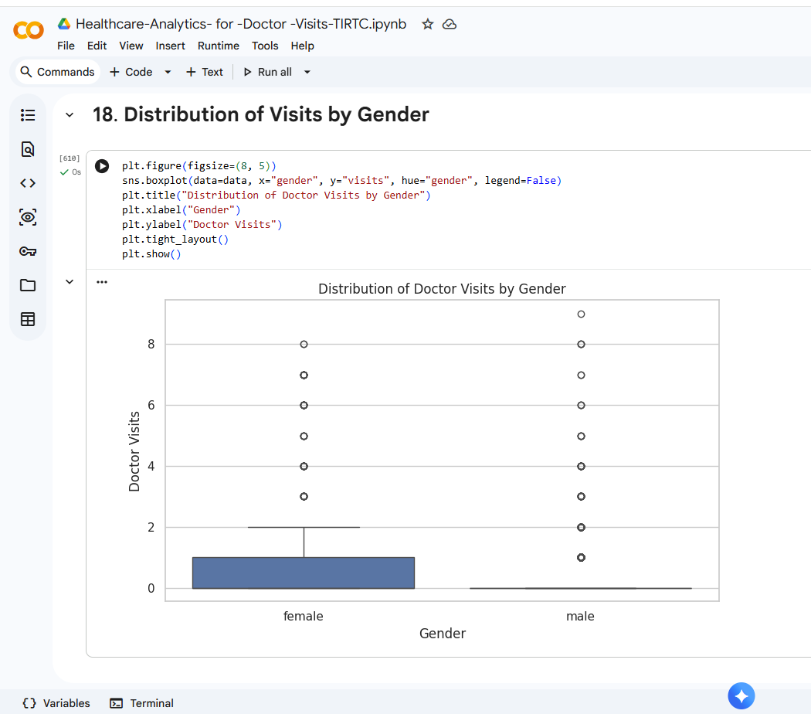
RESULTS

Slide 29
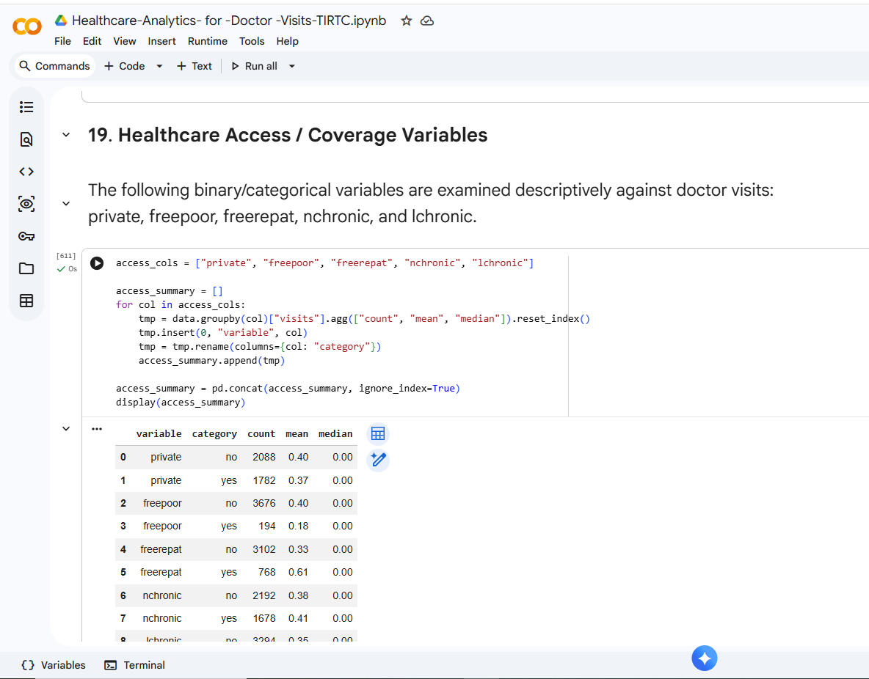
RESULTS

Slide 30
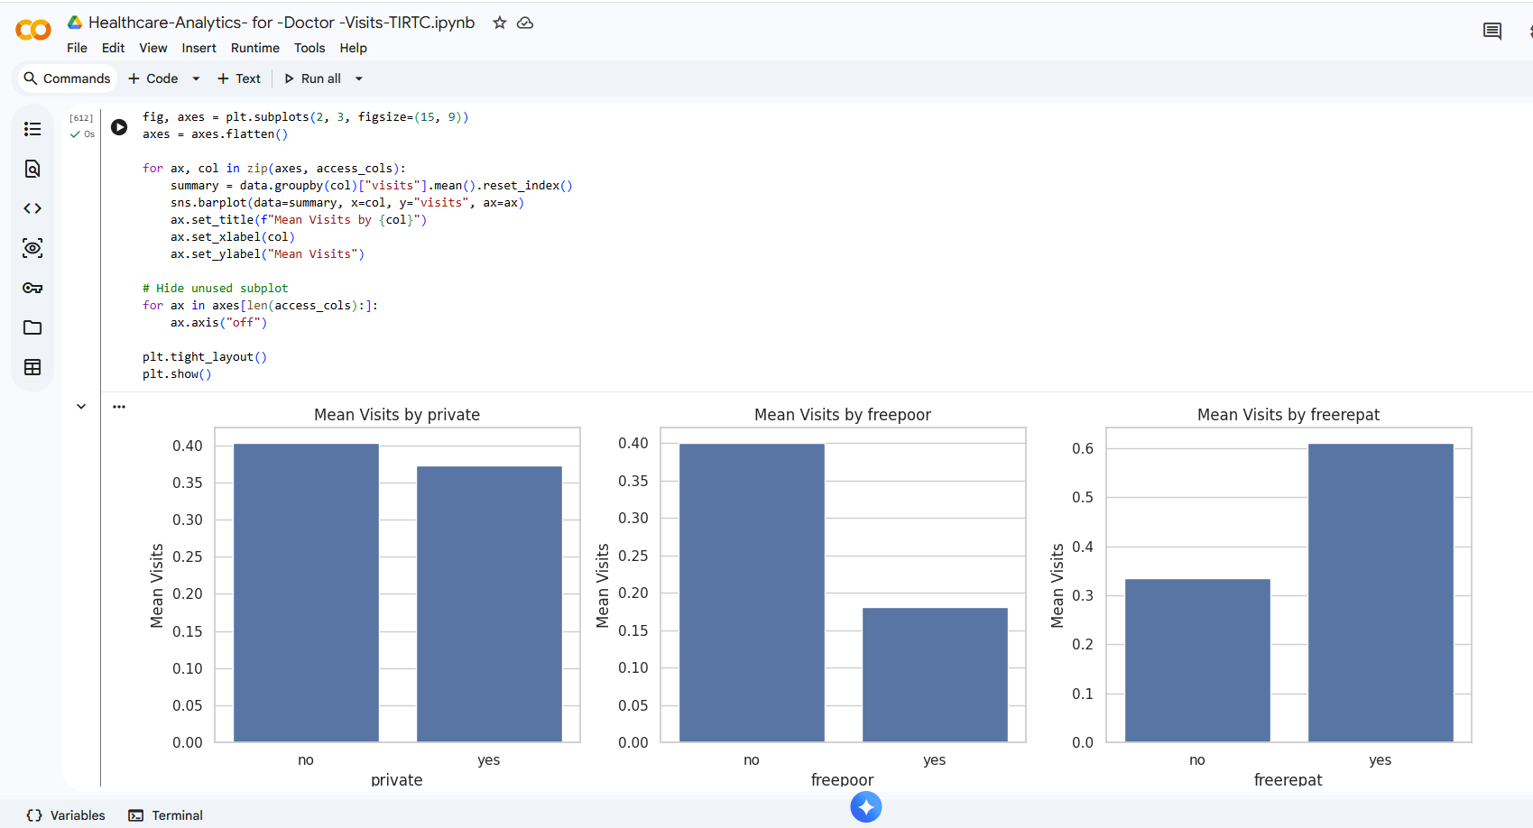
RESULTS

Slide 31
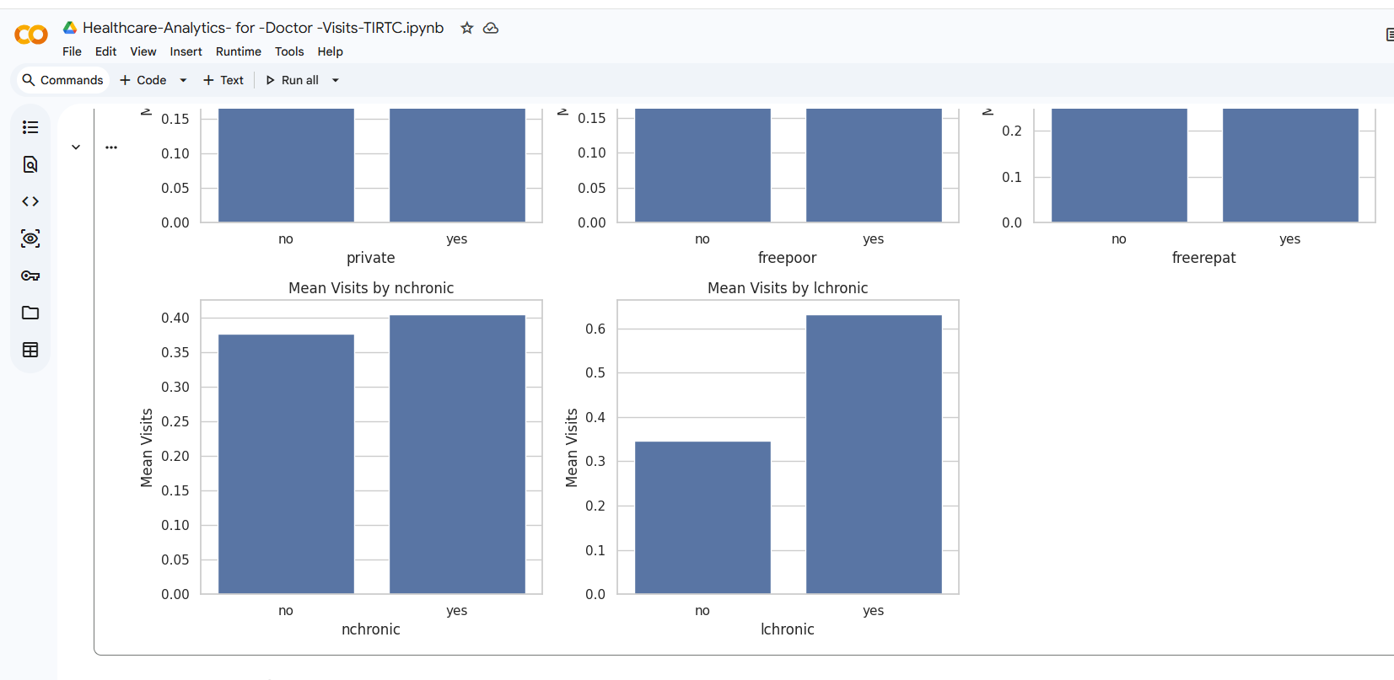
RESULTS

Slide 32
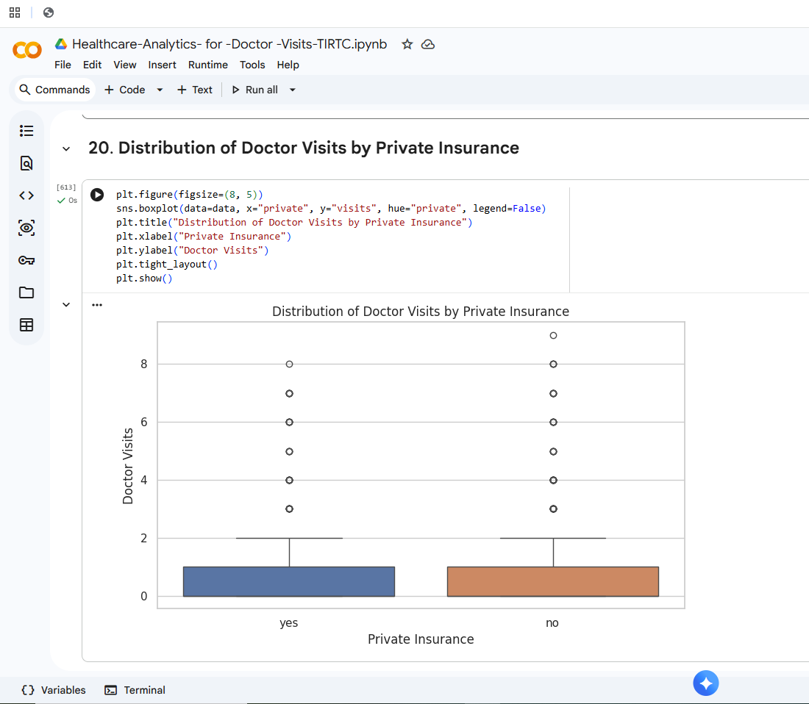
RESULTS

Slide 33
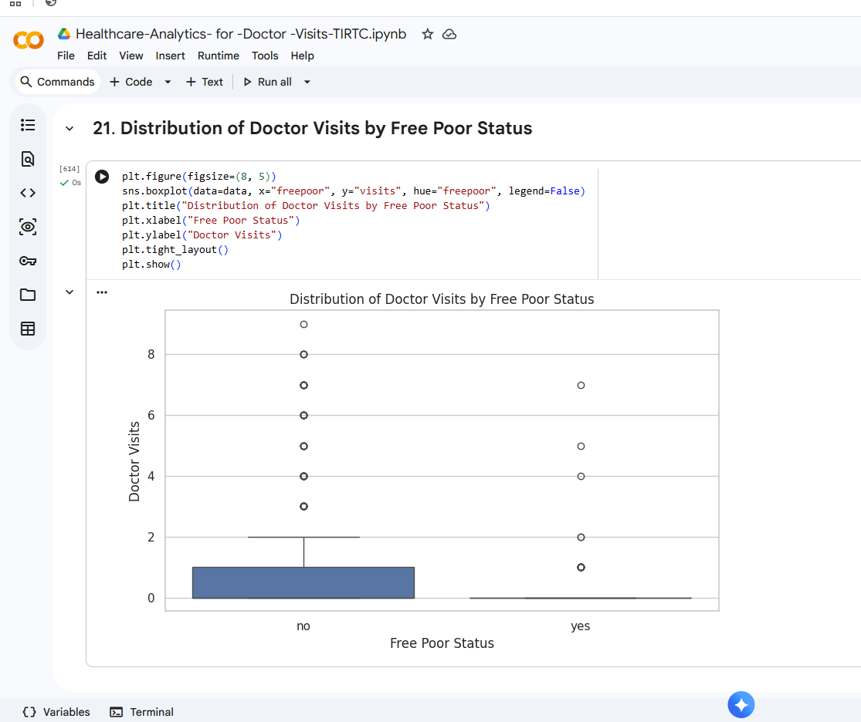
RESULTS

Slide 34
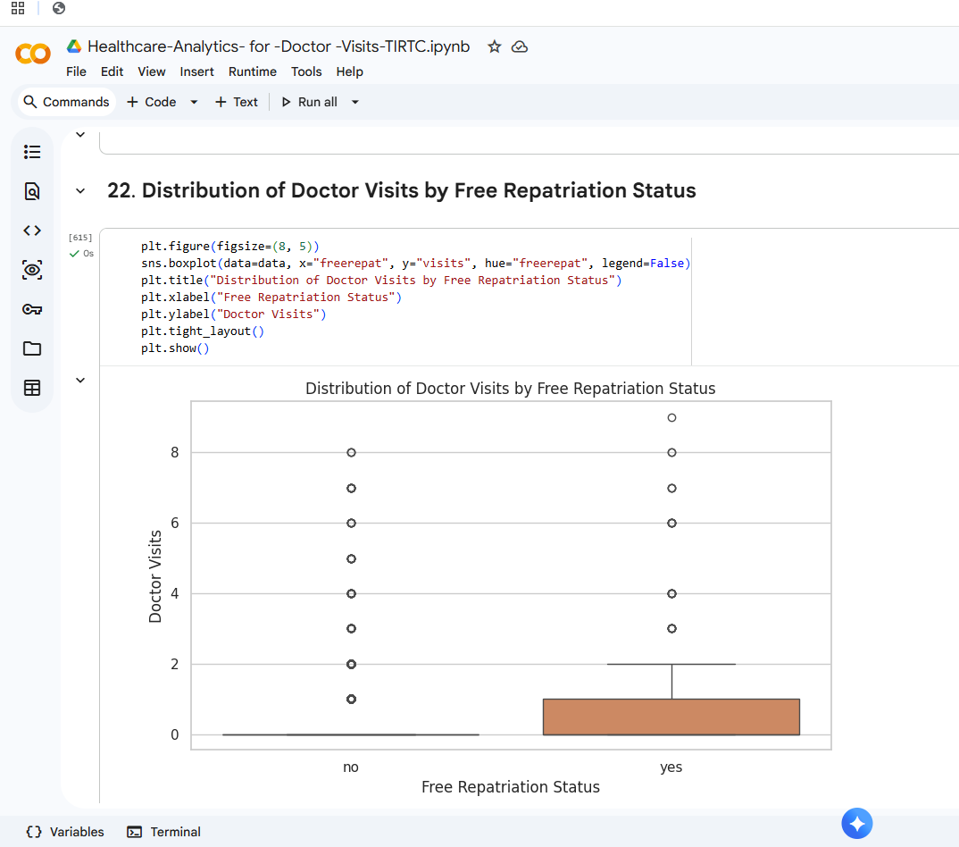
RESULTS

Slide 35
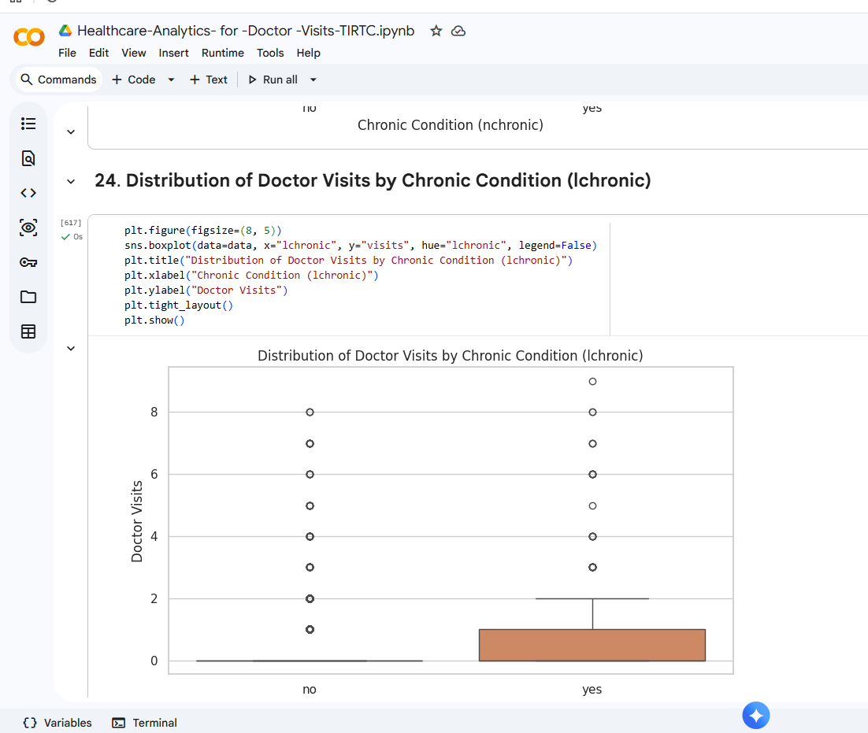
RESULTS

Slide 36
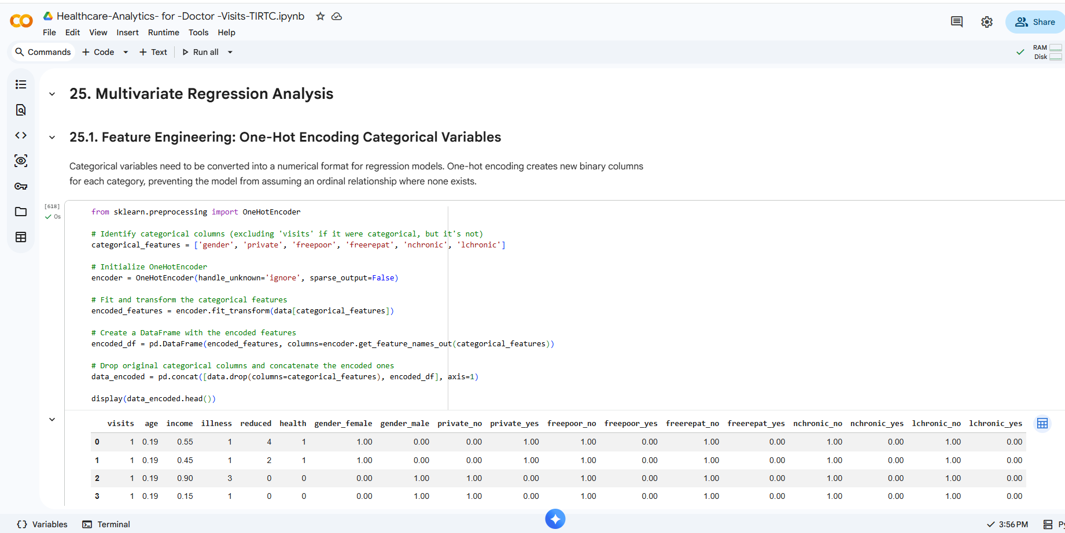
RESULTS

Slide 37
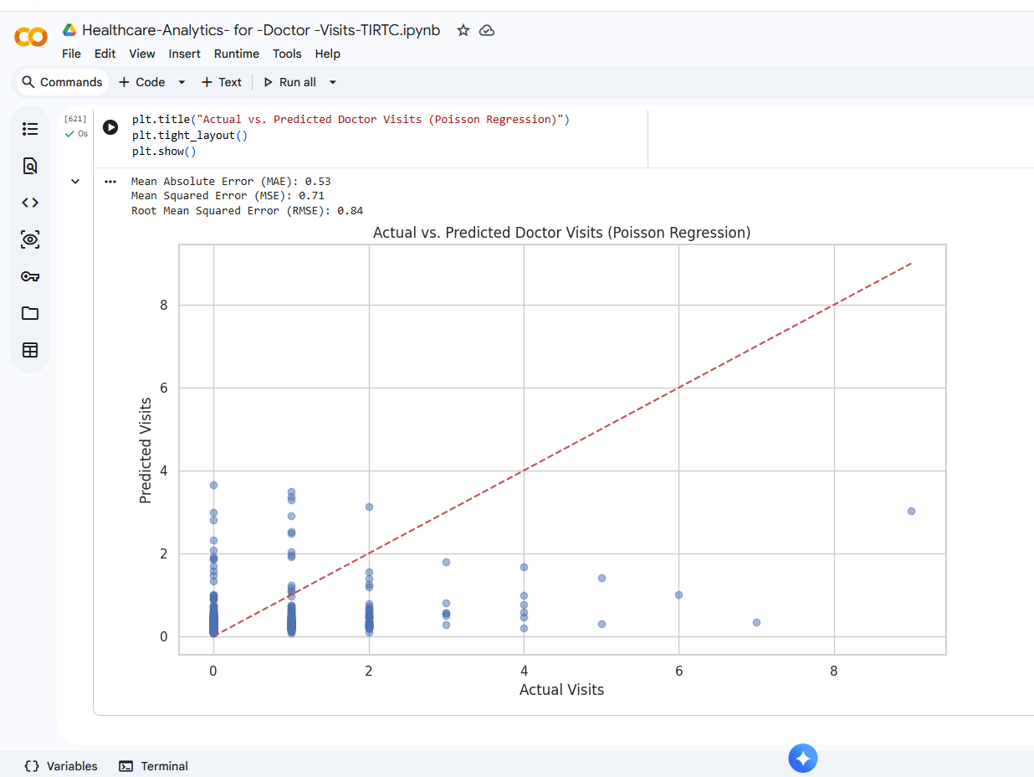
RESULTS

Slide 38
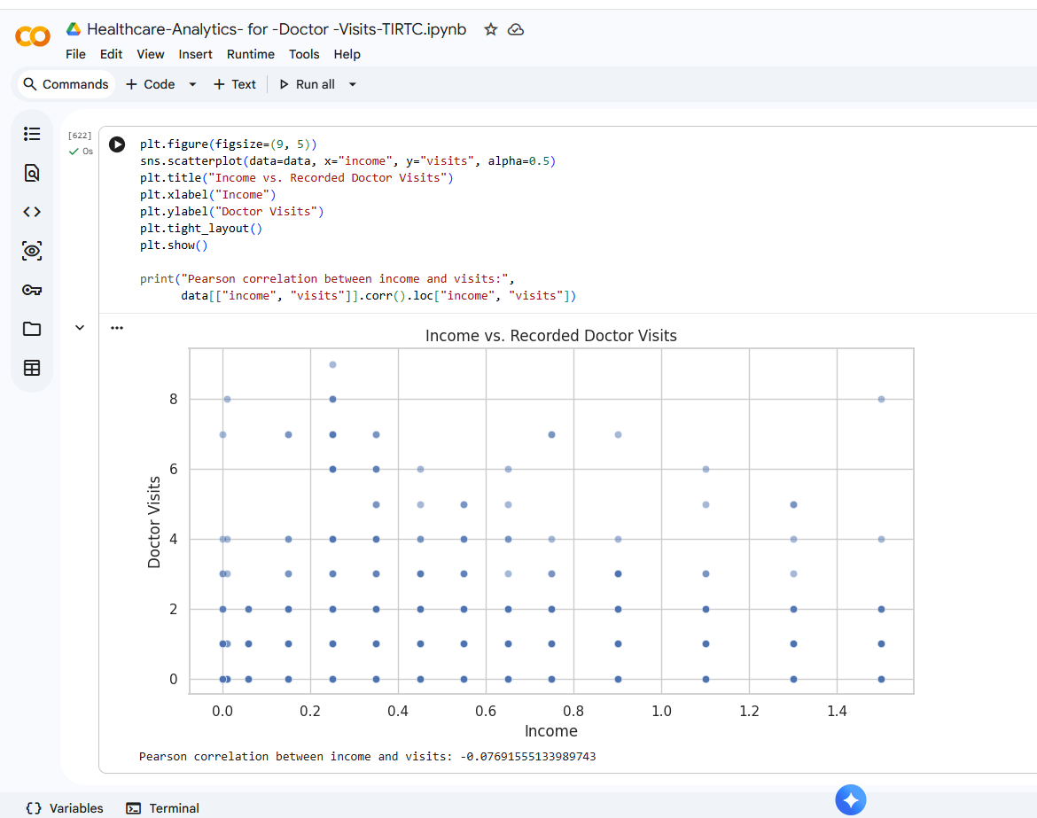
RESULTS

Slide 39
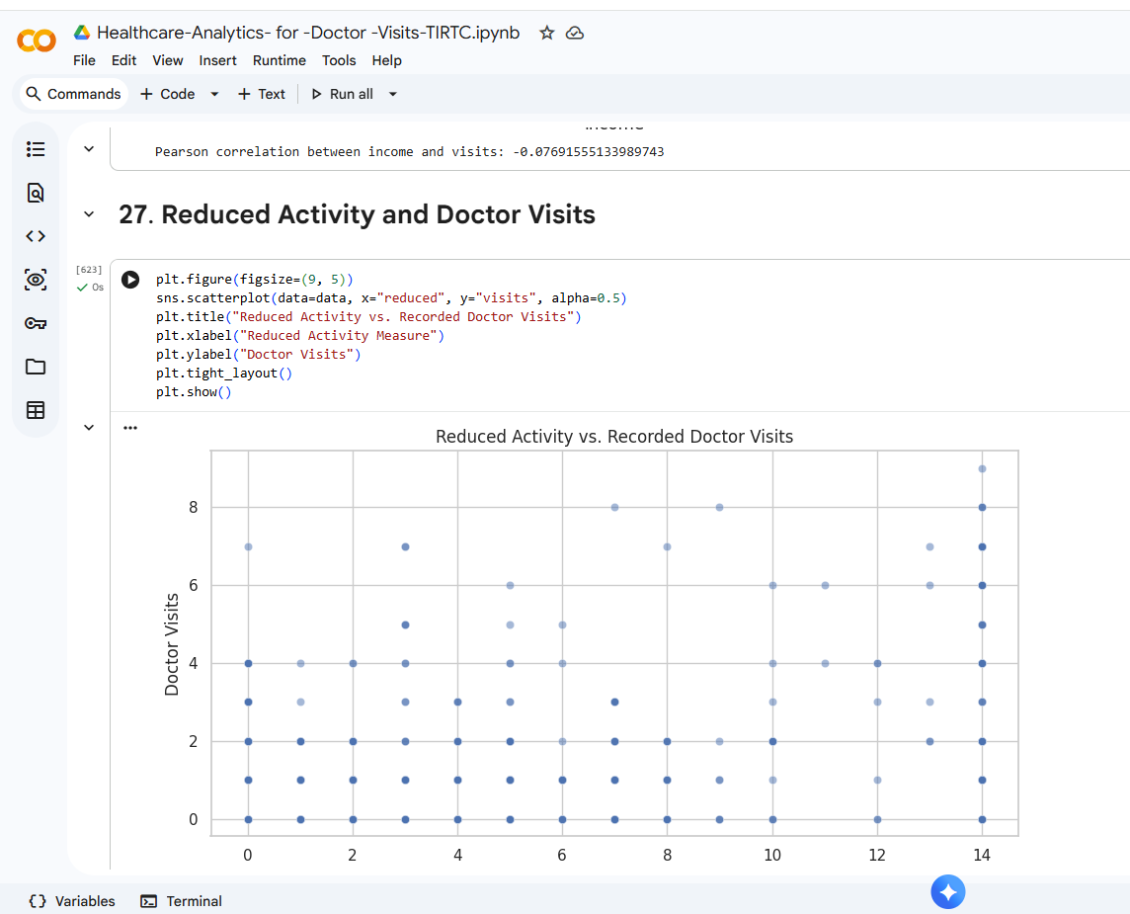
RESULTS

Slide 40
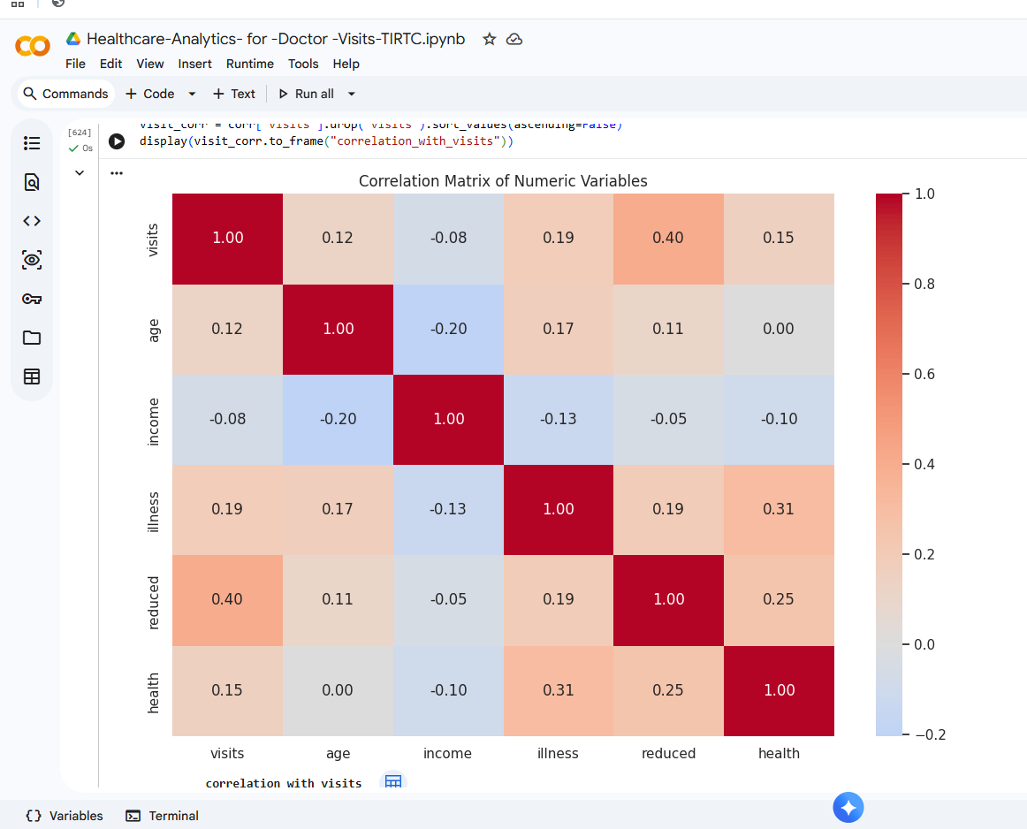
RESULTS

Slide 41
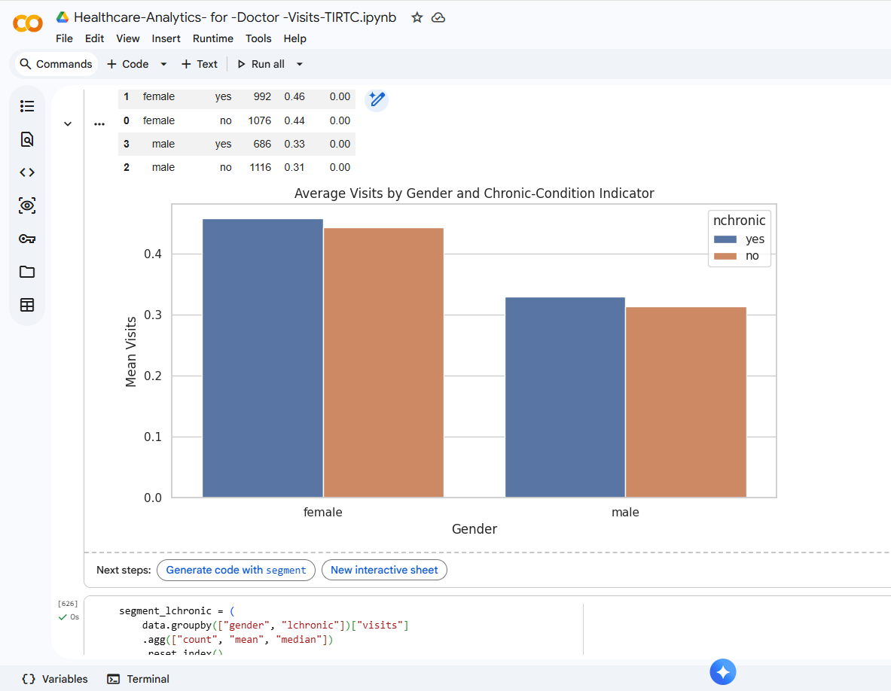
RESULTS

Slide 42
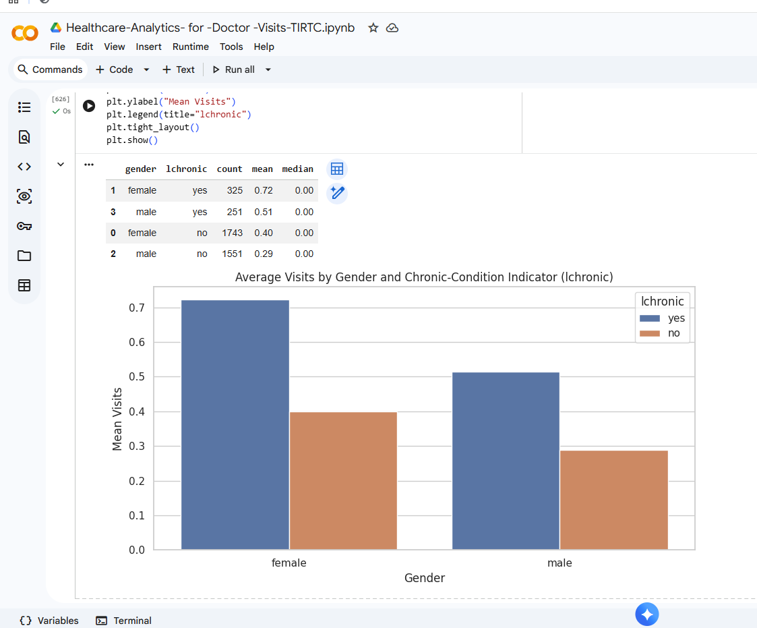
RESULTS

Slide 43
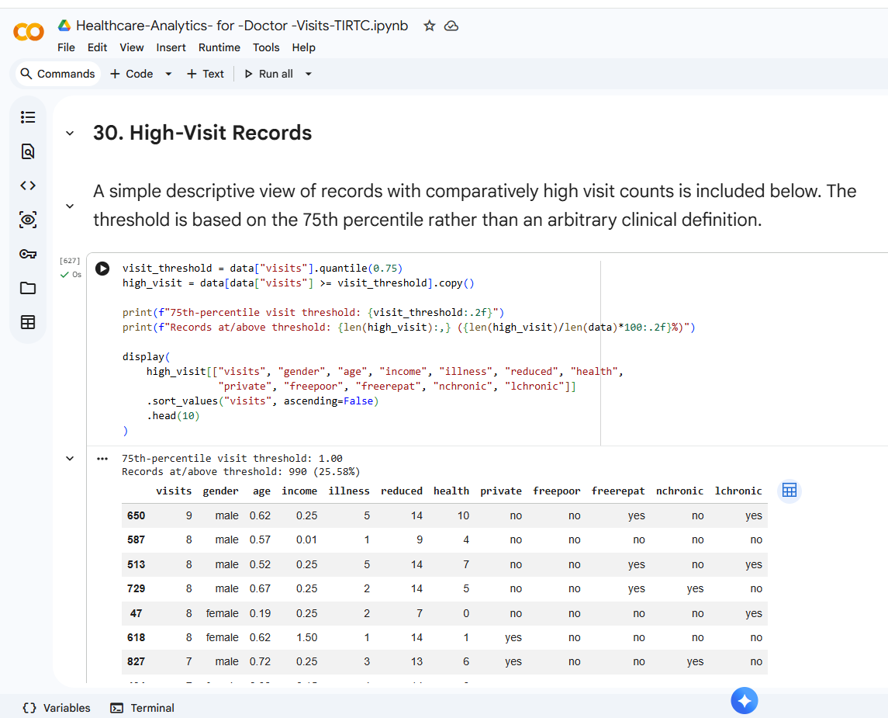
RESULTS

Slide 44
Thank you
Acknowledgement ,
I would like to express my sincere gratitude to the Edunet Foundation, VOIS, and the Vodafone Idea Foundation CSR Program for providing me with the invaluable opportunity to participate in the TIRTC extended internship.
Working on the "Healthcare Analytics for Doctor Visits" project has been an incredibly rewarding experience. This platform allowed me to apply theoretical knowledge to a practical use case, giving me hands-on exposure to data cleaning, exploratory data analysis, and statistical visualization using Python. The experience has significantly strengthened my technical skills and deepened my understanding of how data-driven insights can support healthcare resource planning.
I am deeply thankful to the mentors and the organizing teams for their continuous guidance, support, and for fostering such a strong learning environment.
Sincerely,
Umang Barshe
Student ID: STU6a2c2581ab2571781278081
College name- Takshshila Institute Of Engineering And Technology
.
.

